Slide 1

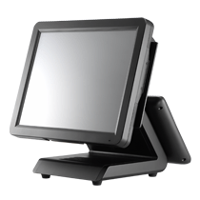

Food & Beverage Management System
Present By : Biz Care Solutions

Slide 2




QubePos Food Court Management System
Windows Apps
Power By Delphi XE3 under Embarcadero Technologies
Database Engine firebird 2.5
Supported o/s: Windows XP/7/8 all editions
Delphi XE3

Slide 3









Qube Retail Management Suite Module

Slide 4
Company Introductions'
Biz Care Solutions
  Total Solutions Provider for Retail Automations System & Auto ID Interfacing.
  15 Years experience in Retail & General Merchandise software solutions and Food & beverage system
  Local Software Development Team
  Auto Id Peripheral interfacing/ Software Customizations
  Network Solutions & Middleware development
  Qube POS Chain’s Client
    Mr DIY ( 80 Store and 240 terminal Nation wide)
    Mr DIY Trading ( Ware House – 86 Terminal )
    S & M Group Warehouse( 125 Store – Various Brand Name)
    Original Thinker ( 7 Store & HQ)
    Sogo KL ( 35 Store )
    Philip Morris Factory ( Cash Less System)
    Wan Lee Heng Group ( 8 Warehouse)
    Restaurant Oversea ( 18 Store – Moon Cake business)
    Subaru Club ( 4 Terminal)
    Little Taiwan ( 3 Terminal)
    KEMANGI CAFE SAJIAN
    RED ON BLACK KTV BAR
    RESTAURANT OK
    COZY STATION BAR
    Canteen Café Bar
    My Rail Kopitiam
Suma Japanese Restaurant
Siang Chinese Restaurant
Shogo Kopitiam
Shogo Café & Bar

Slide 5

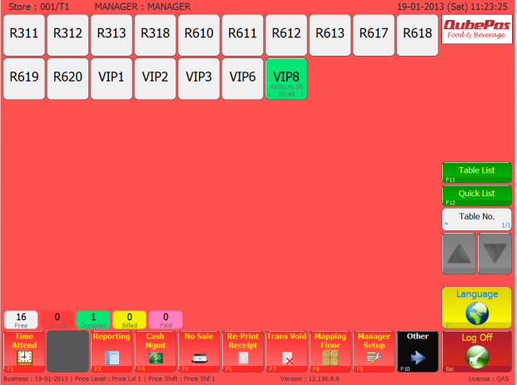
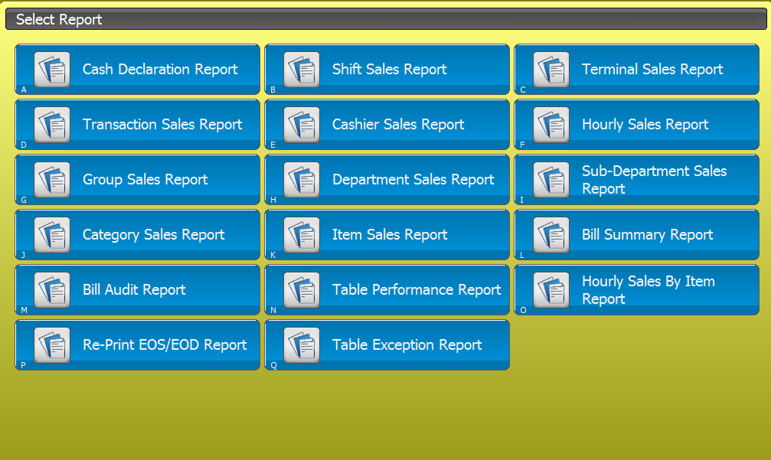
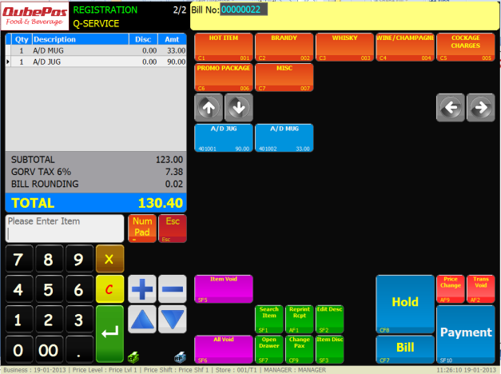
Qube Pos XE Edition
Point Of Sales System
Food Court Management
CMS – Canteen Management System
HR System Interfacing
Third Party Interfacing
Option Second Display- Advertisement Module

Slide 6
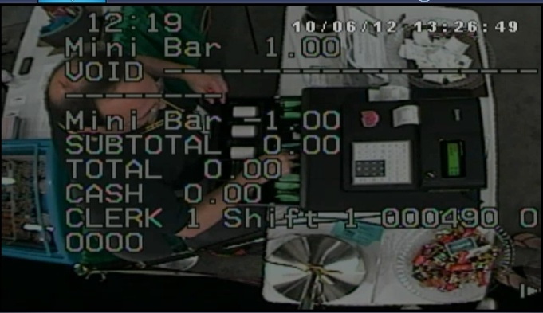
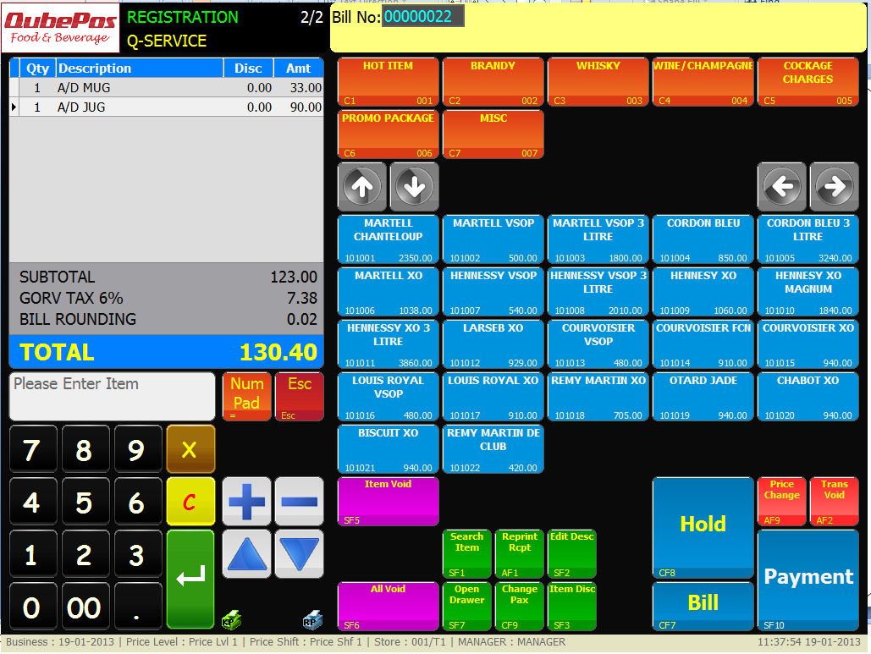
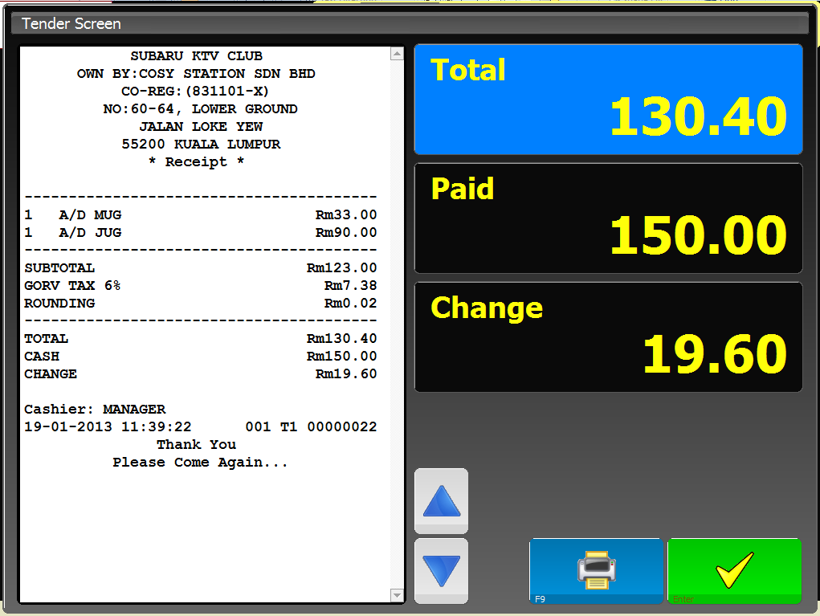
Qube Pos Feature
2 in 1 System – Quick Service And Fine Dining
Graphical layout – High Contract and visibility Layout
Table and Floor Plan Management
Support Up To 99 Kitchen Printer
Split Bill/Combine Table/Table Tranfers
TOV ( CCTV Interface Ready)

Slide 7
Qube Pos Feature
Multi Ware House Stock Inventory With Ingredient Control
Item Void/Transvoid
Promotions Discount/Happy Hour
Member Price/Set Menu Offer
Modifier/Condiment Control
Order Pad/ Order Stations Support

Slide 8



Qube Order Pad – Full Functions
Suppor t IOS –IPAD and Android Tab O/S
  Provide mobile ordering
  Support various Screen Size
  Secure data in server
  Instant login and operations

Slide 9
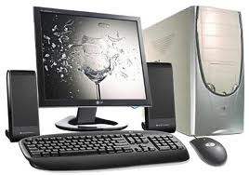
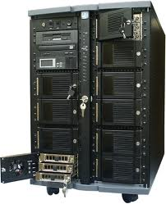
Back Office Solution
Internet
HQ Back Office
Account Reconciliation
Sales Monitoring
Bank In Checking
Back Office
Server
Data Storage
Menu edit
Consolidate report
System Management
Store 1
Store 2
Store 3
Store 4

Slide 10
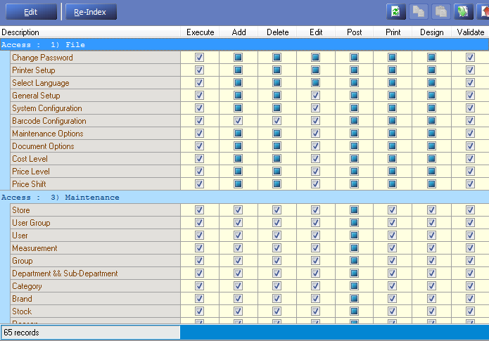
Back Office Security
Group Security Setting
Such as Admin/Manager/Supervisor/cashier
Supervisor Overwrite functions
Execute
Add
Delete
Edit
Post
Print
Design
Validate

Slide 11
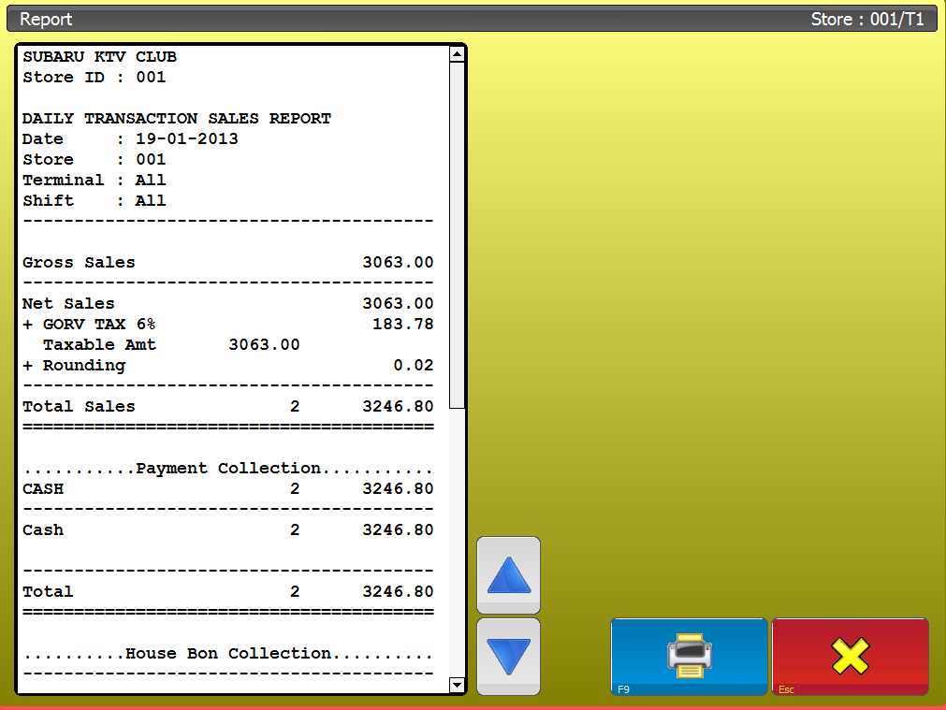
System Reporting
P&L Report Performance
Hourly Item Sales
Daily Reconciliations
Sub department salas
Menu Item Sales
Hourly Report

Slide 12
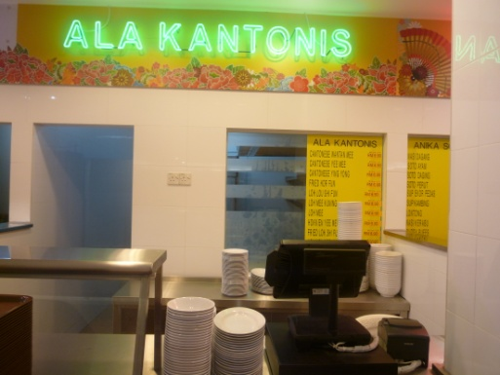
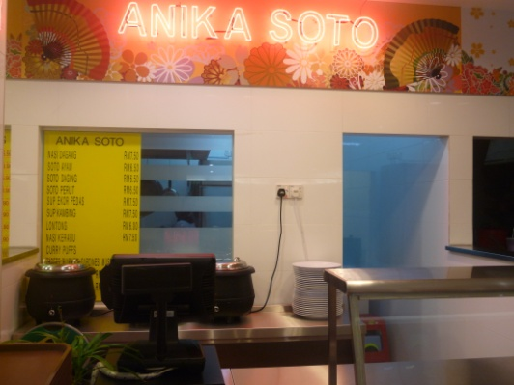
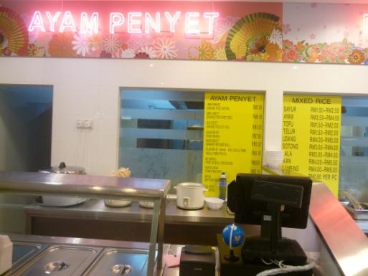
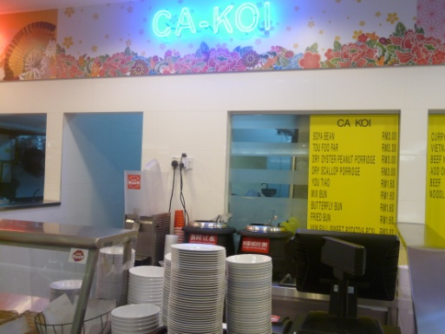
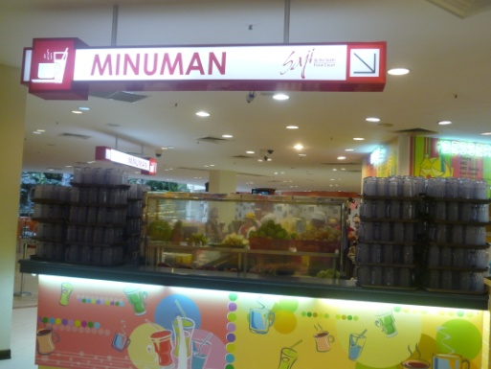
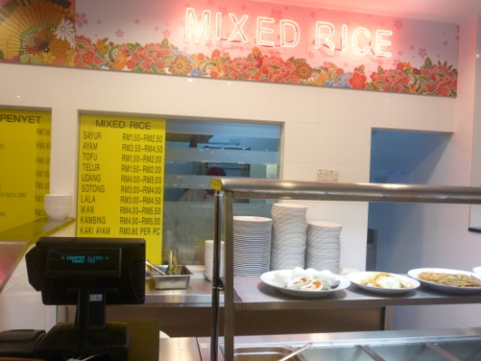
User Reference
Sogo Food Court (30 Store with TOV Link)

Slide 13
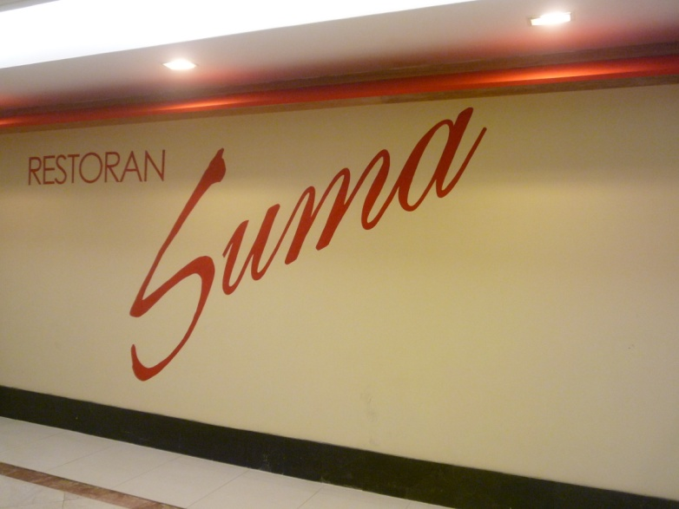
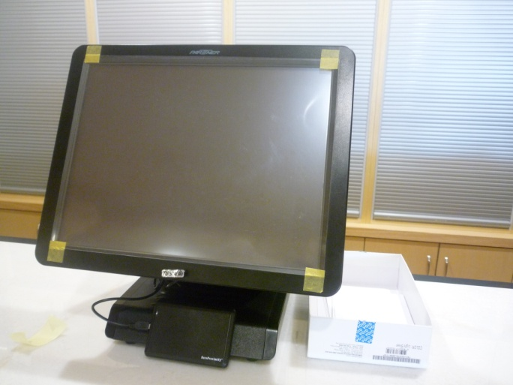
Restaurant Suma
Japanese Restaurant
1 Cashier/2 Order Station/5 KP/2 Order Pad

