Slide 1


1ST JANUARY 2024
Guides On How Clients Generate Client ID and Client Secret for E-Invoice Integration with QubeApps Solutions
Qube Apps Solutions Sdn Bhd | 2024

Slide 2
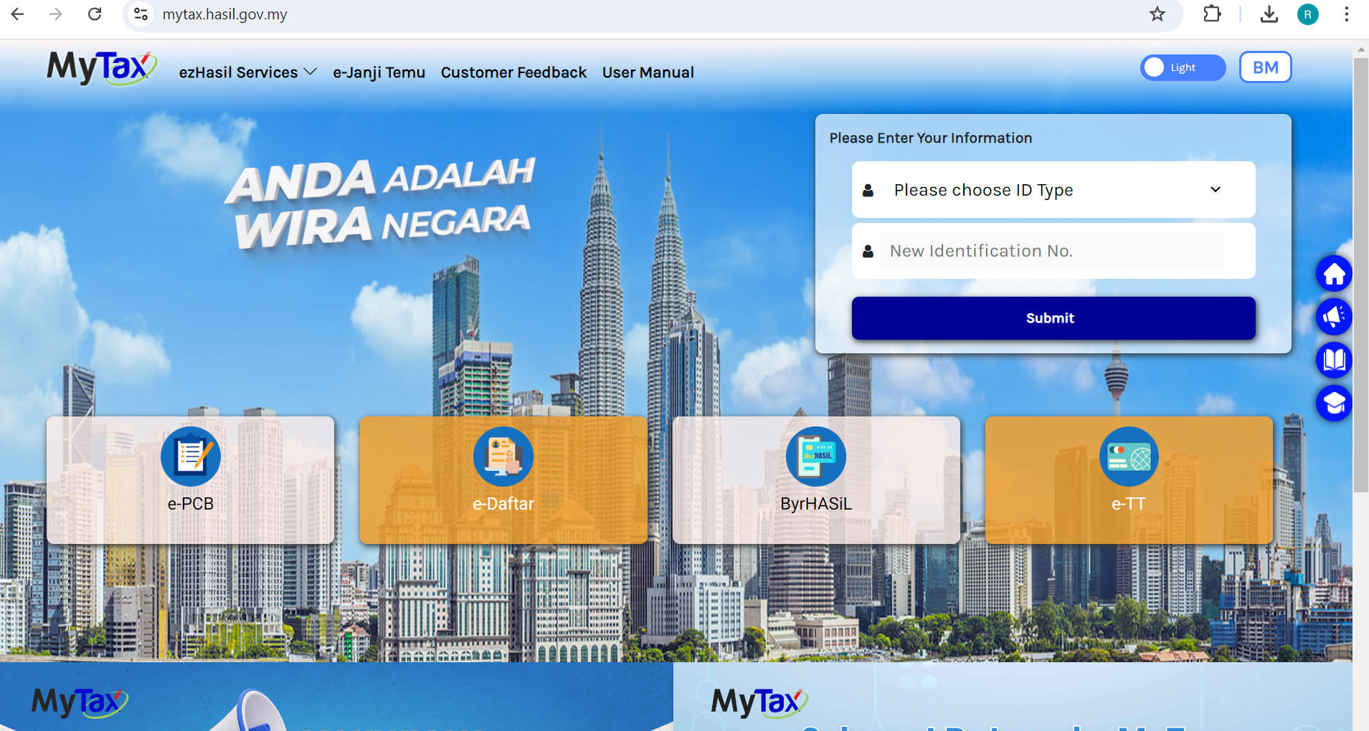
01
1. Client can access https://mytax.hasil.gov.my . Choose ID Type -> Identification Card No and enter your IC No and click “Submit”

Slide 3
02
2. Client will be redirected to URL link -> https://mytax.hasil.gov.my/dashboard-content, go click “MyInvois” menu

Slide 4
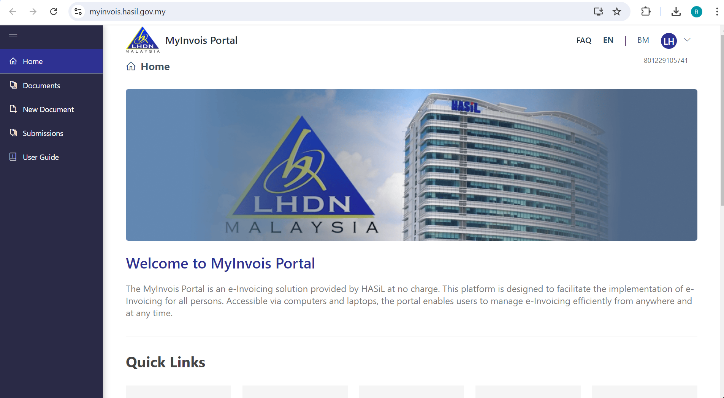
03
3. Client will be redirected to Myivnois Portal(Production) ->https://myinvois.hasil.gov.my/

Slide 5
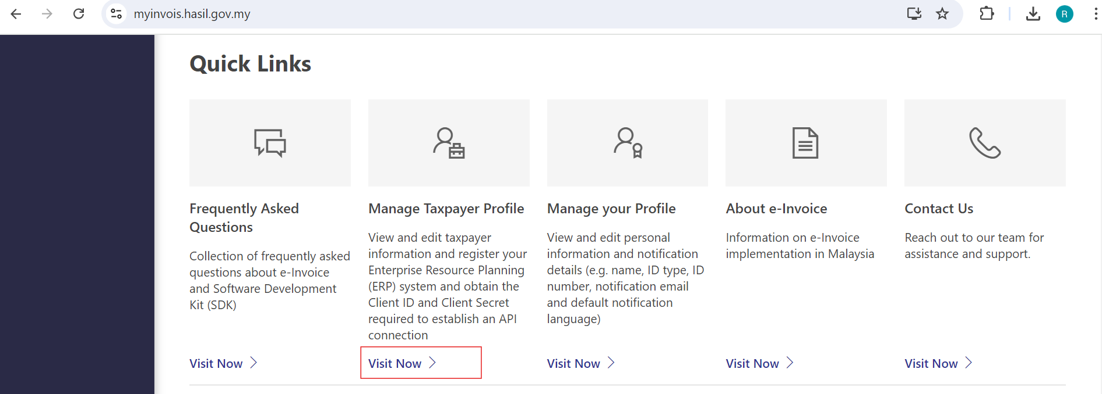
04
4. Client can go to Quick Links , go to “Manage TaxPayer Profile” and click “Visit Now”

Slide 6
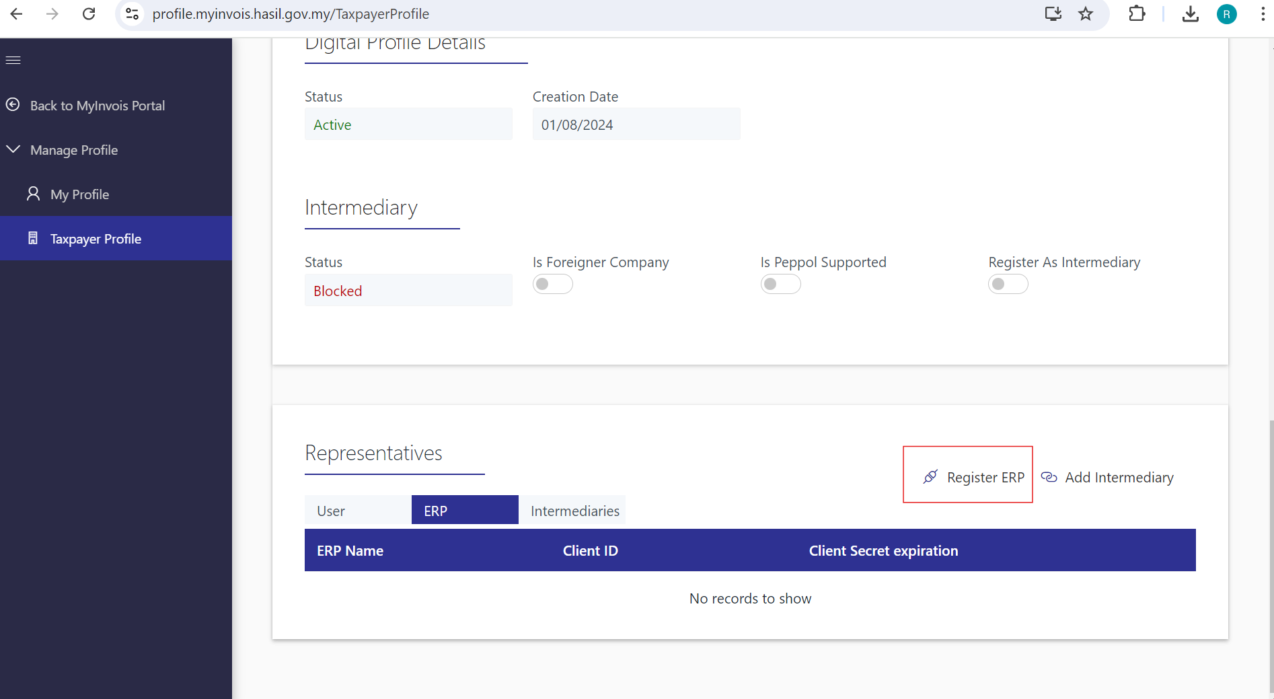
05
5. Client can scroll to “Representatives” section under Taxpayer Profile , go click “Register ERP”

Slide 7
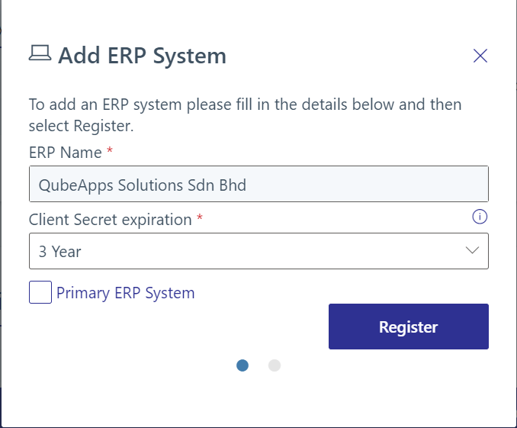
06
6. Client can key in ERP Name “QubeApps Solutions Sdn Bhd” and select Client Secret Expiration “3 Years” and click “Register” button

Slide 8
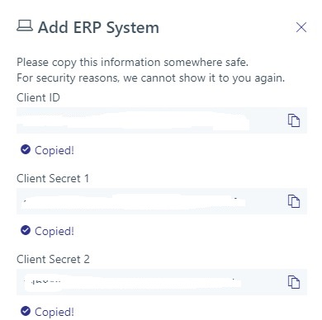
07
7. Client can obtain Client ID, Client Secret 1 & Client Secret 2 generated from MyInvois Portal which can be handed over to QubeApps for E-Invoicing integration.

Slide 9


DD/MM/YYYY
THANK YOU
Qube Apps Solutions Sdn Bhd | 2024

