Slide 1



IRC
Cougar V9
Restaurant POS System
By Inter-Register Communications (M) Sdn Bhd & Authorized Dealers of IRC Cougar POS Software

Slide 2
Contents Page
Company Profile
Software Introduction
Software Features
Successful Stories
2

Slide 3
Cougar V9
Company Profile
Company Profile
Facility of Customer
Combination of POS Software & Hardware
3

Slide 4

Company Profile
Established in 1987, Inter-Register Communications (M) Sdn Bhd (IRC) is the sole distributor of CASIO Malaysia. IRC provides total POS management solutions including software, hardware, supports and system consultation complete with digital security solutions through our sister company IRC Systems.
Company Address
Bangunan IRC , 34, Jalan Tanjung SD13/1,
Bdr Sri Damansara, 52200 Kuala Lumpur, Malaysia.
Website
www.irc.com.my
Nature of Business
Casio Cash Register
POS System for Retail & FNB
Product Line
Casio ECR/POS System (Major)
Cougar Retail POS System (V7 and V8)
Cougar V9 FnB POS System
Seito F&B and Q Fast POS Systems
Main Principal
Casio Computer Co. Ltd. Japan.
Seito Systems Limited, Hong Kong
FlyTech Technology (HK) Ltd
4

Slide 5
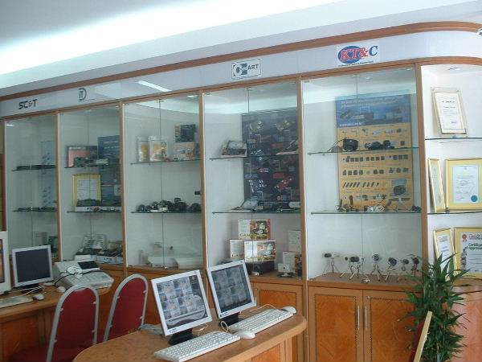



Facility for Customer
Show Room & Live Demo
Pre-Sales Assistant
Training Facility
Helpdesk & System Support
Technical Support
5

Slide 6
Cougar V9
What type of hardware need for POS System?
6

Slide 7

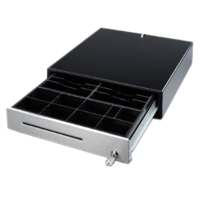
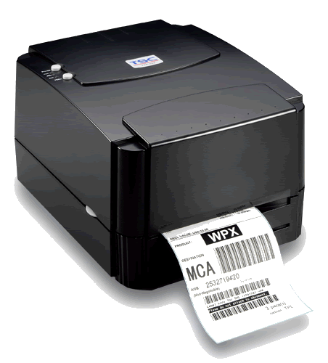
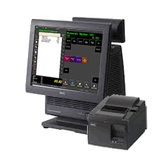



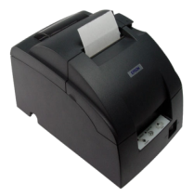
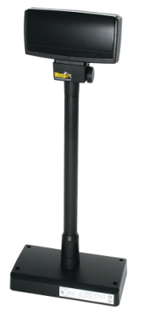
POS Combination
Backup Battery
Barcode Printer
Cash Drawer
MSR Reader
Window license &
POS Software
Customer display
Barcode Scanner
Receipt Printer
7

Slide 8
Cougar V9
Software Introduction
Type of Stores
Restaurant System Concept
8

Slide 9
Cougar V9
What kind of store is suitable to use Cougar V9 POS System?
9

Slide 10

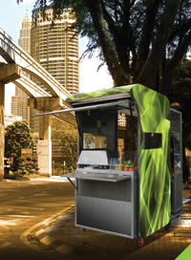
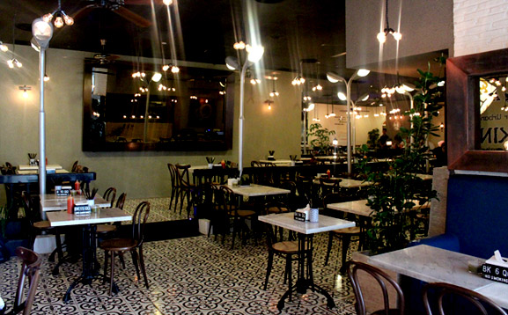
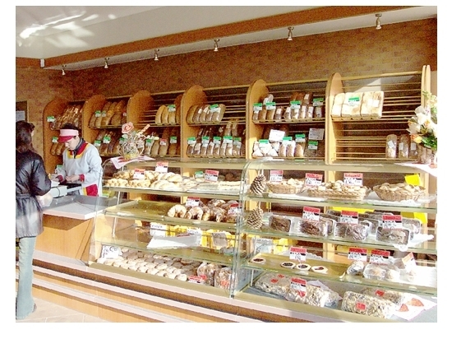
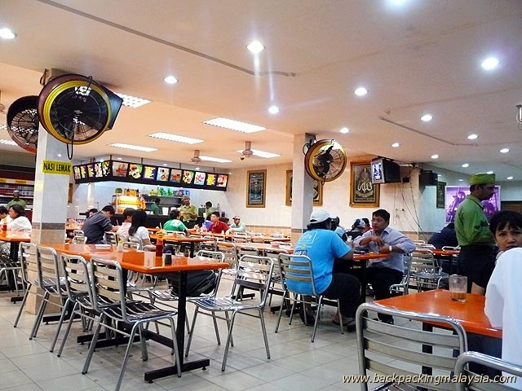
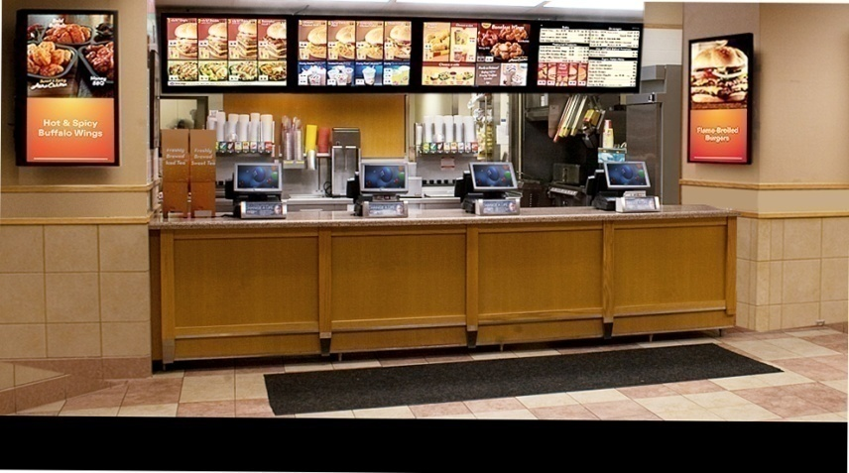
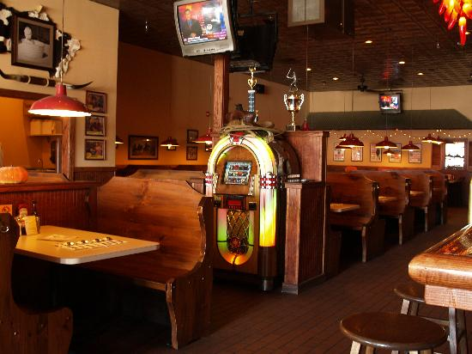
Type of Stores
Pub & Bistro
FNB Kiosk
Mamak Restaurant
Kopitiam
Bakery Shop
Quick Service Restaurant
Western Food Cafe
10

Slide 11
Cougar V9
What type of Restaurant Concept?
11

Slide 12

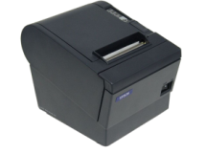

System Flow
Punch in Order into Terminal
Stored Order in Cashier Terminal
Item Sent
Item Sent
Waiter Receive
Order from
Customer
Bar Printer
Order Terminal
Cashier Terminal
Request
Settlement
Kitchen Printer
12
Customer

Slide 13
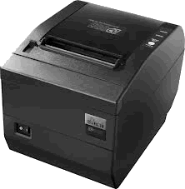
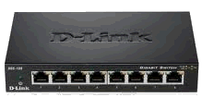
Fine Dining System Concept
Fine Dining System Concept
Cashier Terminal
Kitchen Printer
Network Switch
Bar Printer
Western Food Restaurant
Kopitiam
Pub & Bistro
Cafe
13
Order Terminal 1
Order Terminal 2

Slide 14

Quick Service System Concept
Cashier Terminal 1
Network Switch
Cashier Terminal 2
Fast Food Restaurant
Canteen
Food Court
14
Cashier Terminal 3

Slide 15
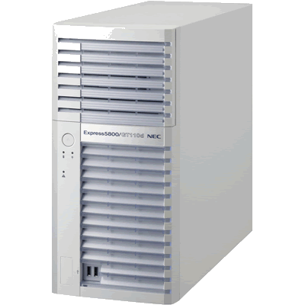
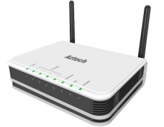
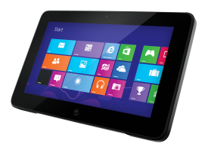
Wifi Tablet Order System Concept
Cashier Terminal 1
Kitchen Printer
Tablet Server
Wifi Router
Bar Printer
Mamak Food Restaurant
Fine Dining Restaurant
Food Court
15
Order Tab 1
Order Tab 2
Order Tab 3
Order Tab 4

Slide 16
Cougar V9
Software Features
Design Framework
System Requirement
System Modules
16

Slide 17
Design Framework
Database
MSSQL Server 2005/2008 Express Edition
Reporting
Crystal Report
Framework
.Net 2.0
Programming Languages
VB.net, C#.net, Java, VB6
17

Slide 18
System Requirement
Microsoft Windows XP Pro
7
8
Operating System
Intel Dual Core
Core 2 Duo
i3
i5
i7
Processor
1GB and above
Memory
10GB for Database
4GB for Installation
Hard Disk
Min Resolution
1024 x 768
Display
18

Slide 19
System Modules
Front End Point of Sale
Back Office Maintenance Tools
Backend Analysis Report
19

Slide 20
Key Features
Customizable Table Floor Management
Multiple Discount Functions (Single Item/Total Bill Discount
Unlimited Payment Mode (Cash, Visa, Master, etc…)
Attendance Time Clock (Clock In & Out)
Split, Combine & Transfer Table
System Log File Tracking
Fine Dine / Quick Service Order Concept
Refund & Reverse Bill Function
Cash Management (Paid In & Paid Out)
Inventory Stock Management
Item Condiment & Modifier Function (Kitchen Message)
Periodical Promotion (Special Discount & Price)
Multiple Access Level
Vendor & Customer Database Management
Multiple Zone Area Management (Indoor & Outdoor Seating)
Kitchen Department Management (Kitchen, Bar, etc…)
Sales Audit Tracking (Void / Cancel Bill)
Extensive Analysis Report
20

Slide 21
Cougar V9
Front End Point of Sales
21

Slide 22
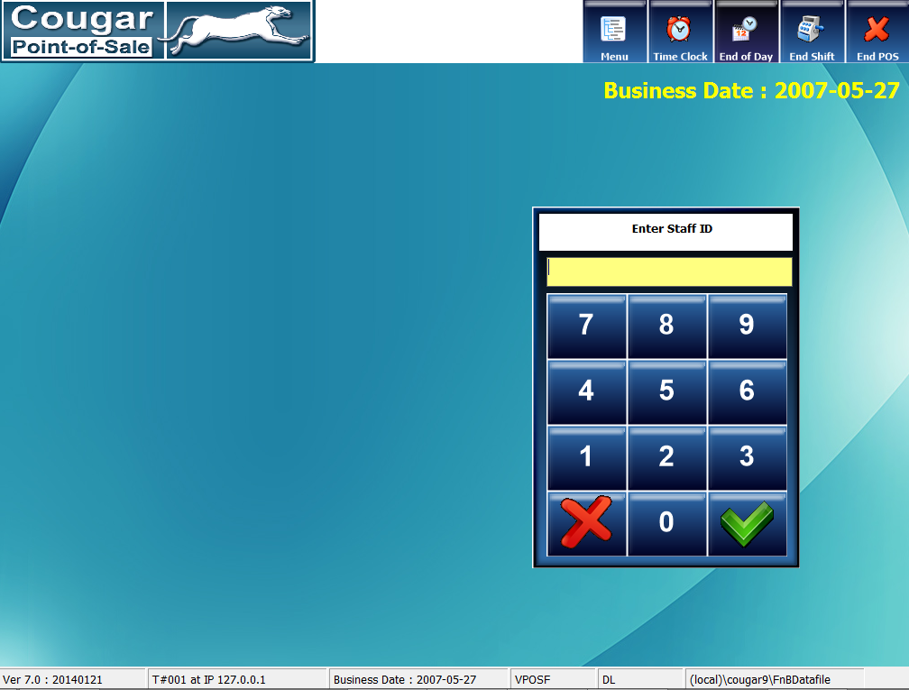

Front End-Log in
Main Page of Front End Log In Screen
Log-In
22

Slide 23
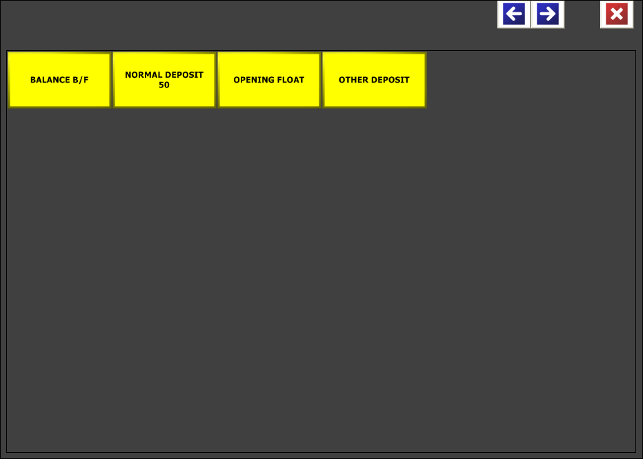

Front End-Open Fund
Open Fund is petty cash for your daily business to give change to customer while payment or pay bill to supplier
Open Fund
23

Slide 24
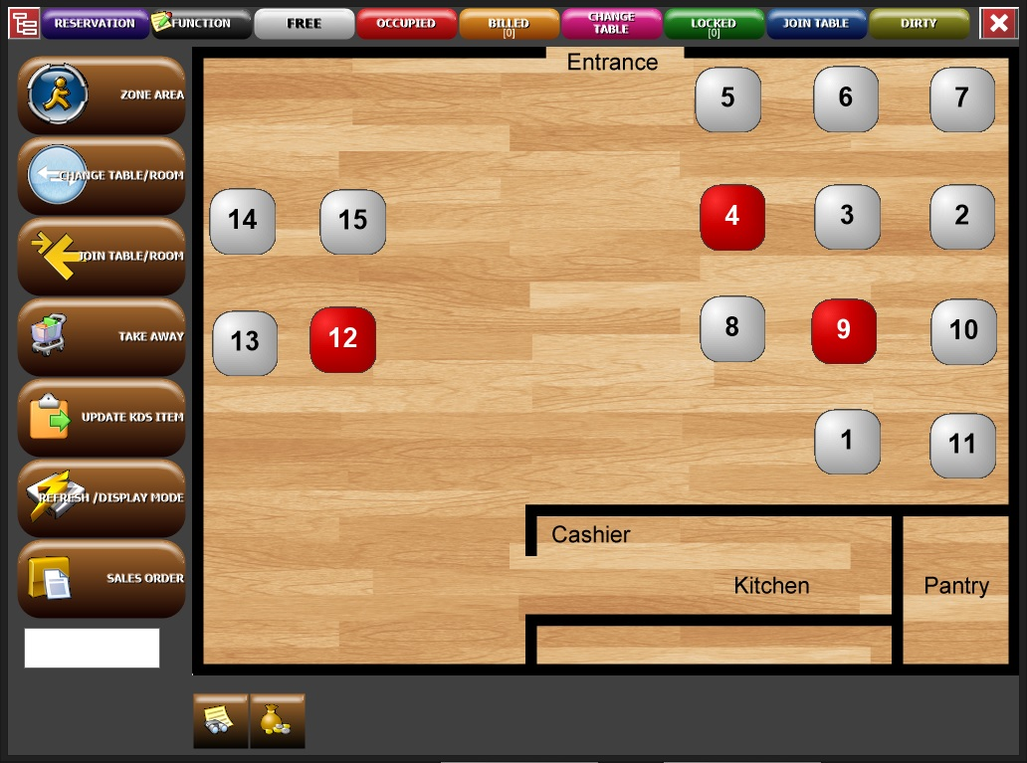
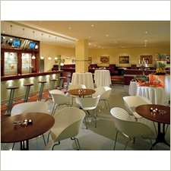
Front End-Tables Control
Customize table floor plan with real table arrangement easier for user to make order
Tables Control
24

Slide 25
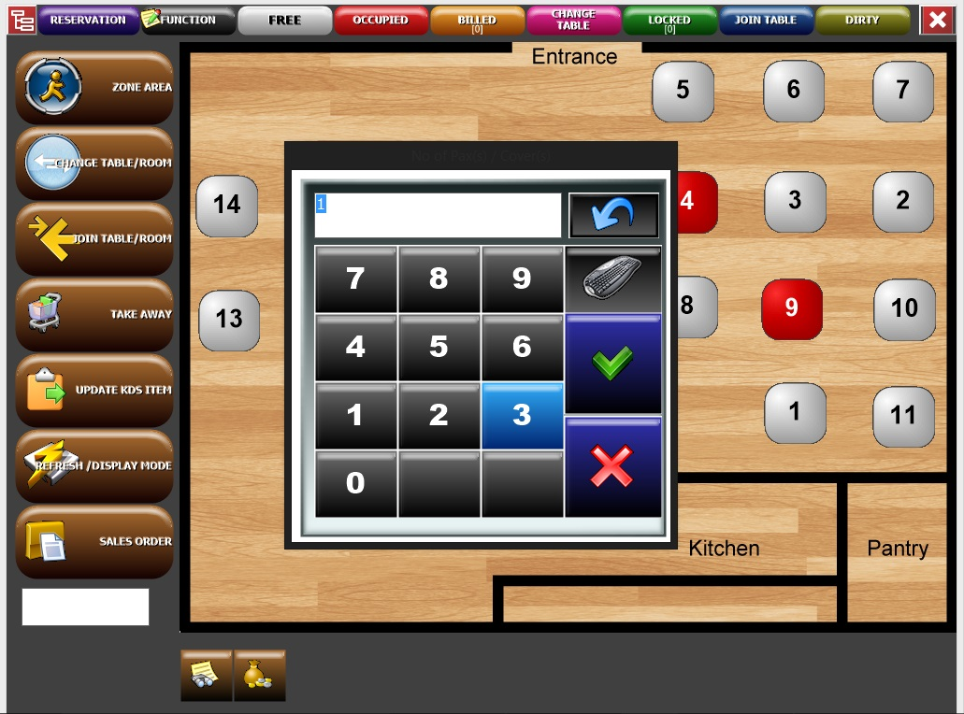

Front End-No of Pax(s)/Cover(s)
Can easily keep track average of daily customers
No of Pax(s)/Cover(s)
25

Slide 26
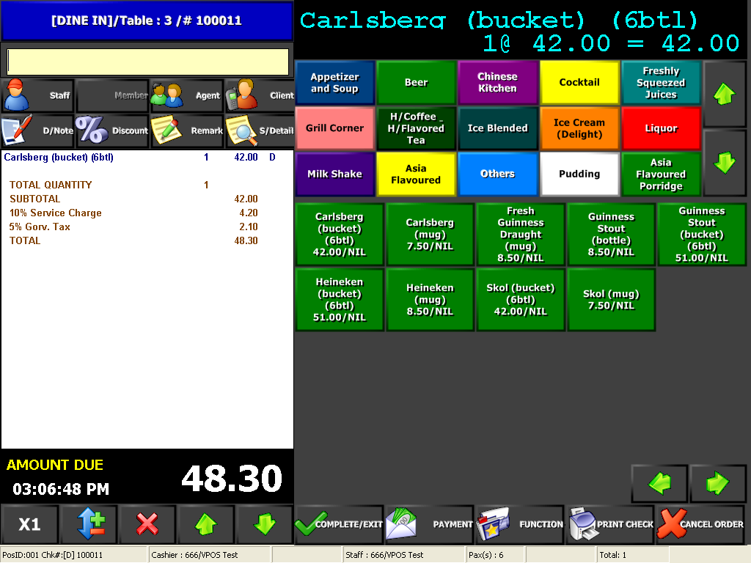
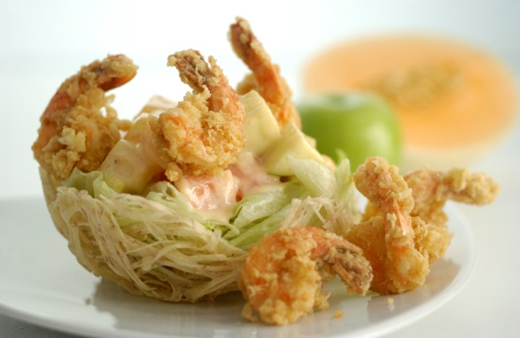
Front End-Item Order
Tidy item button arrangement and button color changeable for user quickly find the items
Item Order
26

Slide 27
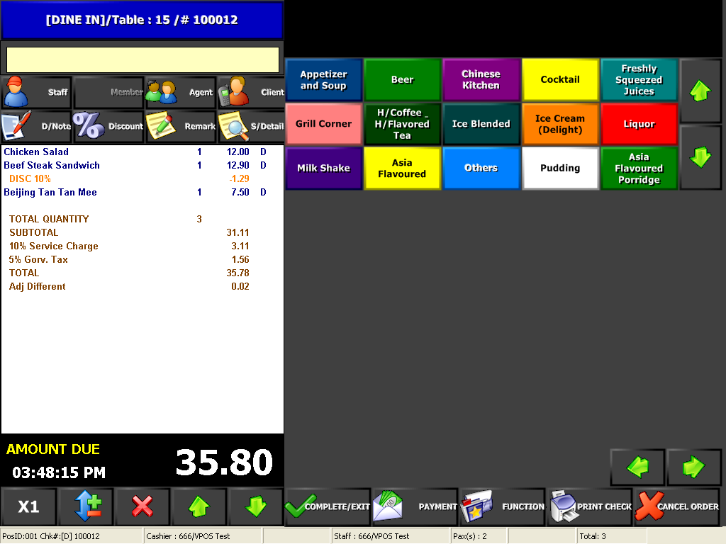

Front End-Item Discount
To give rewards back to customer at promotion period (Single Item / Total Bill Discount)
Item Discount
27

Slide 28
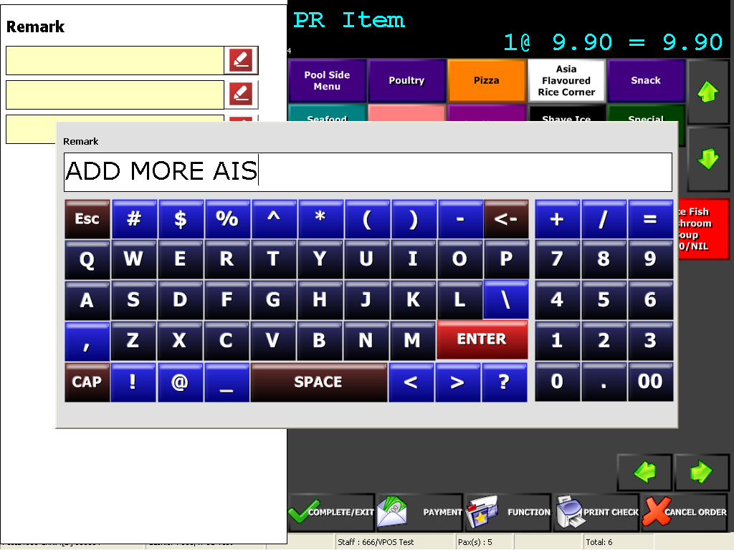

Front End-Order Remark
Order Remark
28

Slide 29
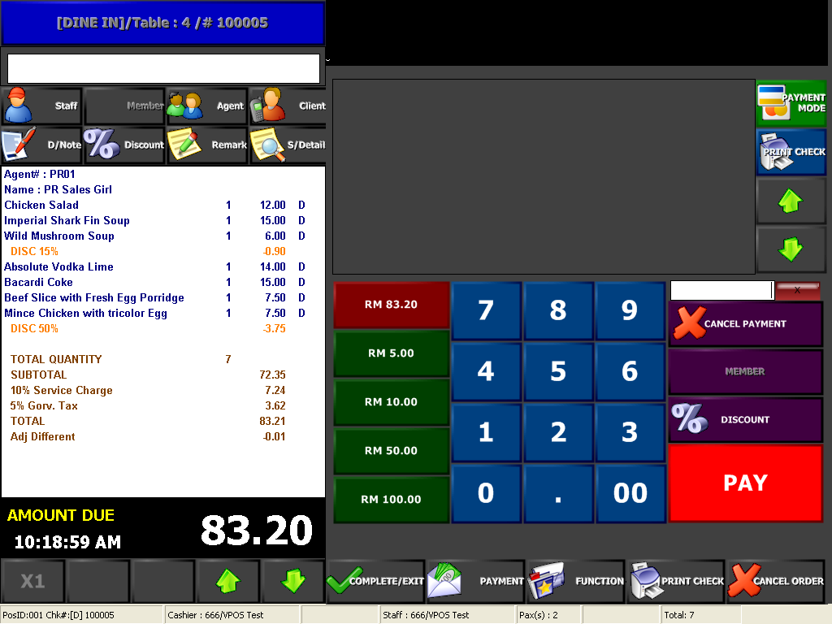

Front End-Payment
Payment
29

Slide 30
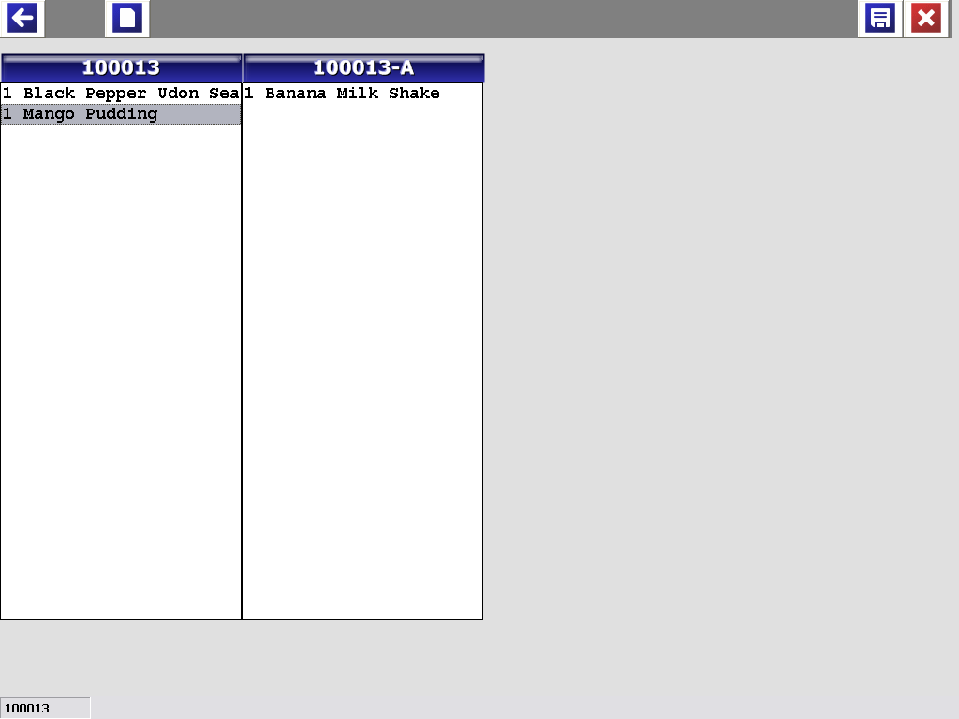

Front End-Split Check
Easily to split bill for customer request to separate payment
Split Check
30

Slide 31
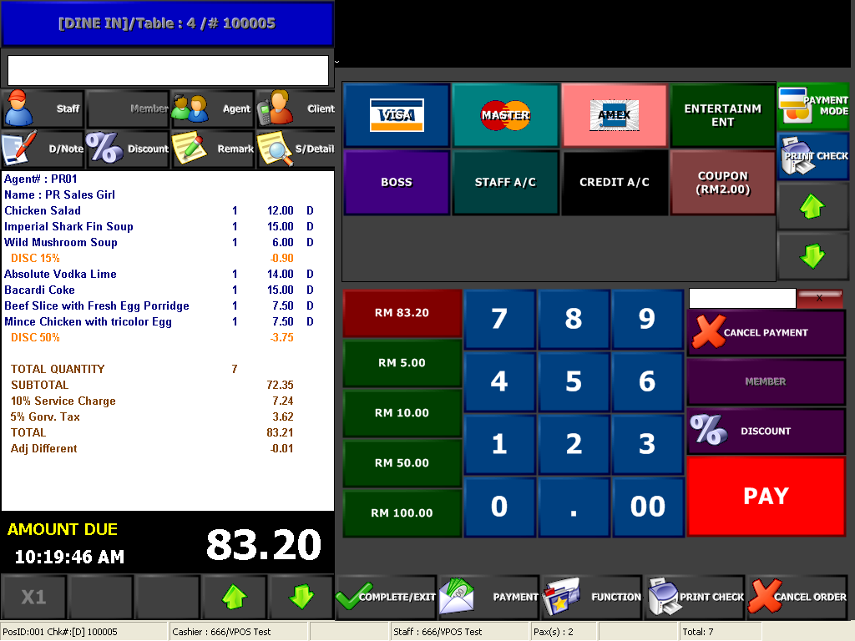

Front End-Payment Mode
Multiple Payment mode to make user easier to manage collected sales money
Payment Mode
31
Multiple payment mode to make user easier to manage collected money

Slide 32
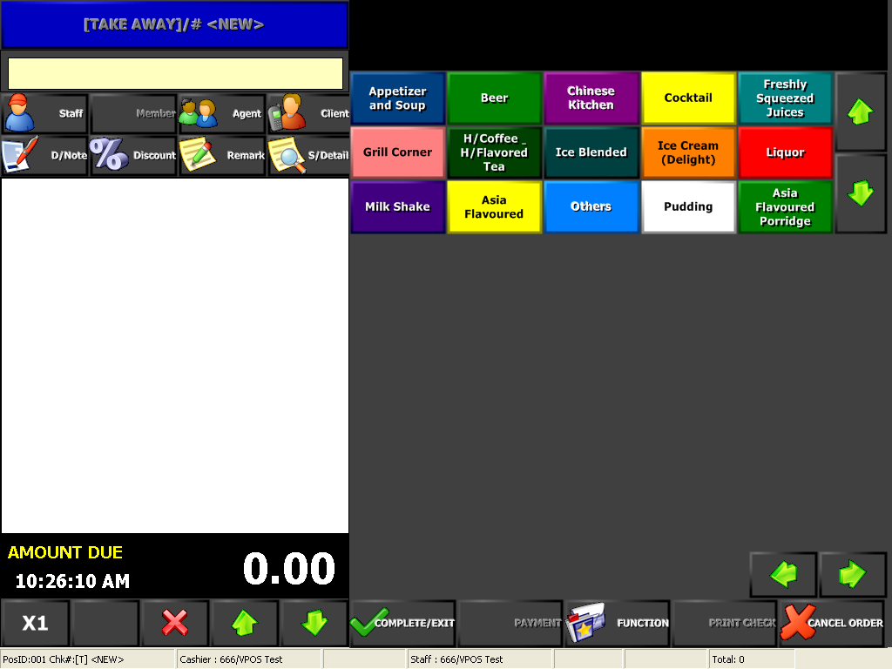

Front End-Take Away
Quick and fast ordering screen for take away customer
Take Away
32

Slide 33
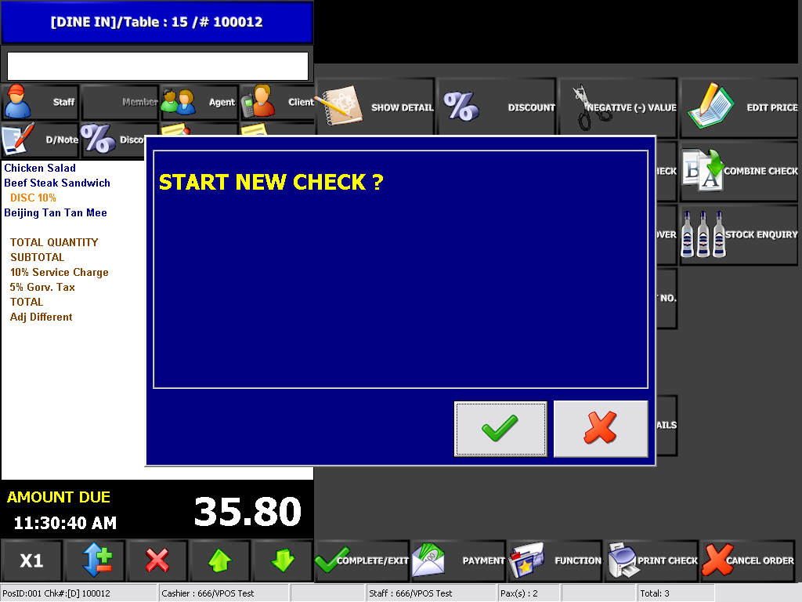

Front End-New Check
To create multiple bills in same table (Different customer sharing same table)
New Check
33

Slide 34
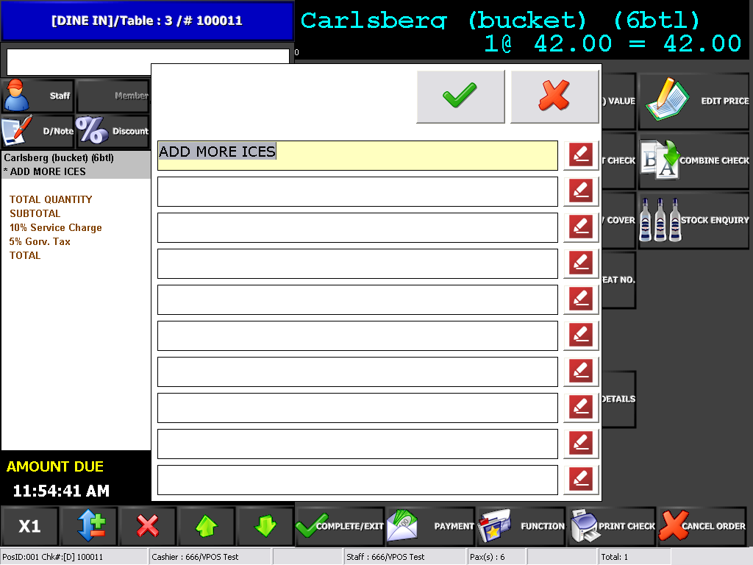

Front End-Note Display
Distinguish between the different requirement from customer
Note Display
34

Slide 35
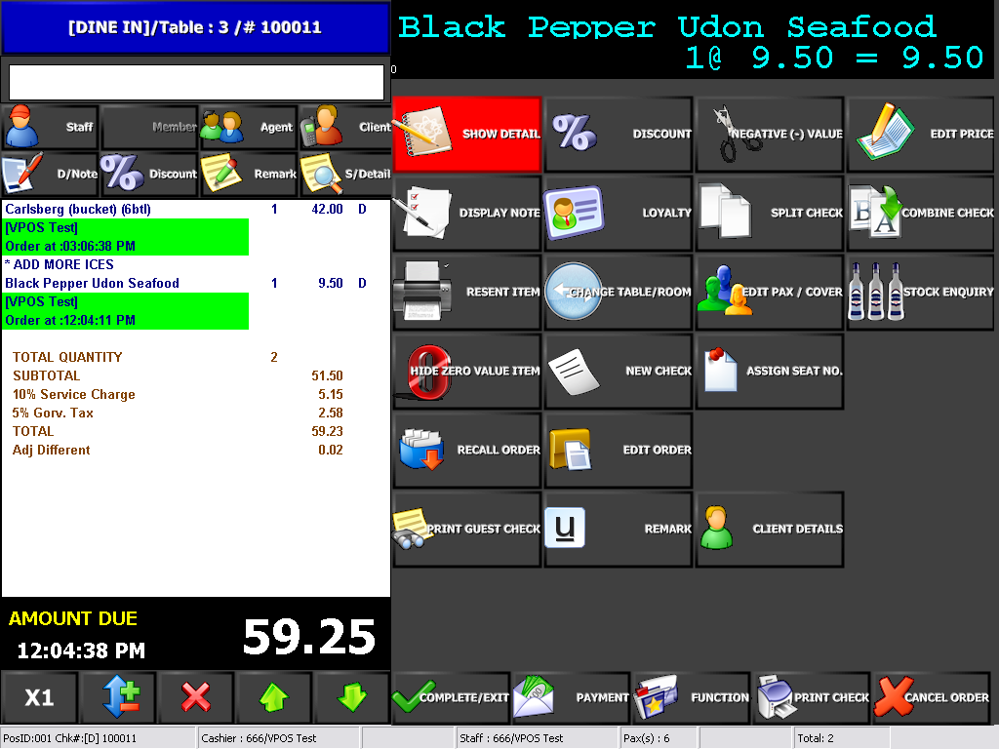

Front End-Show Detail
To view and track ordered items by different user and time
Show Detail
35

Slide 36
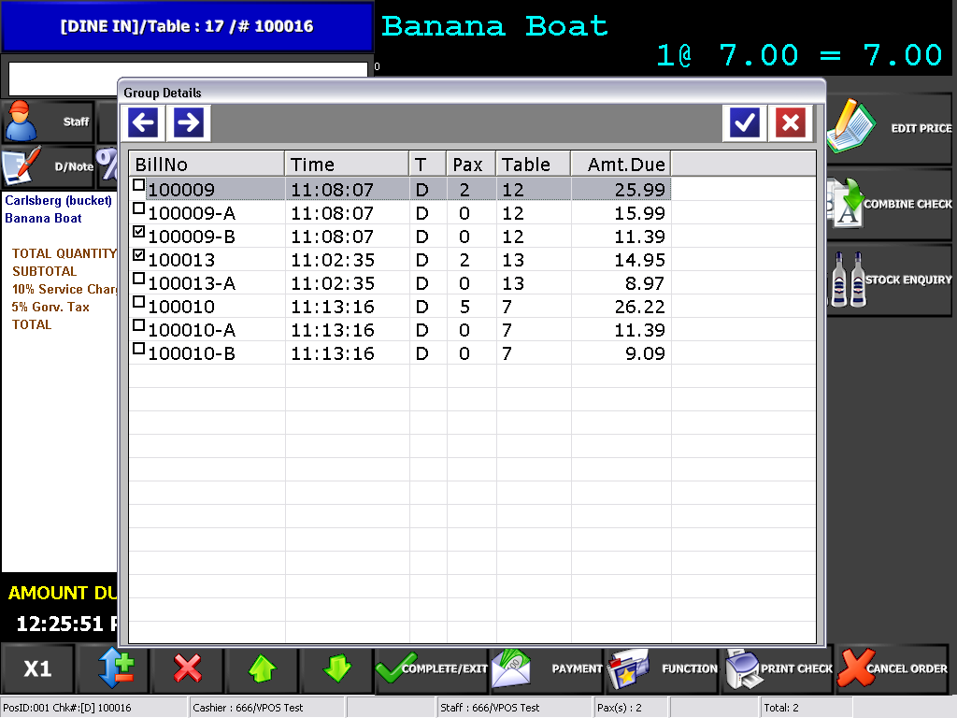

Front End-Combine Check
To join or combine multiple bills to make payment together
Combine Check
36

Slide 37
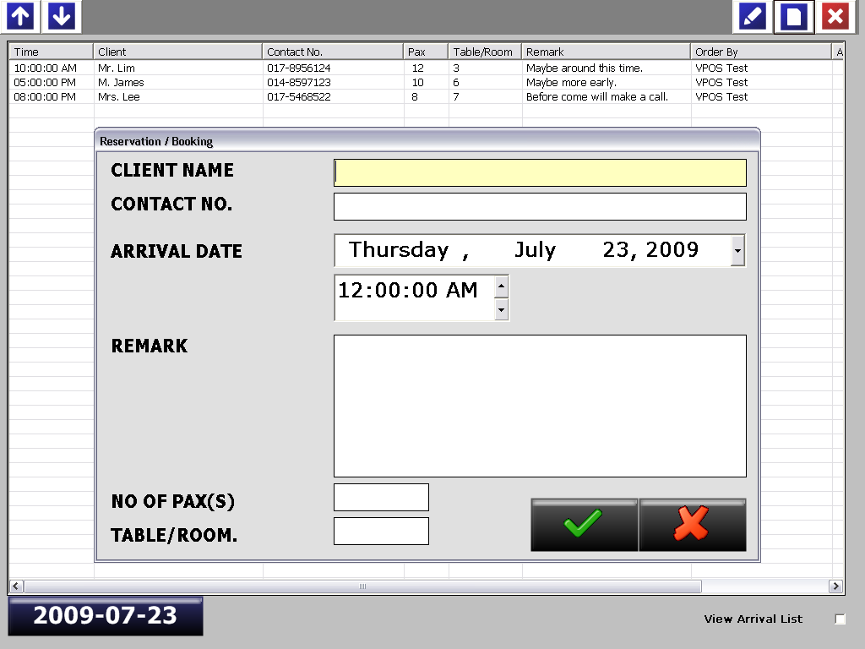

Front End-Reservation
To fill in customer reservation details
Reservation
37

Slide 38
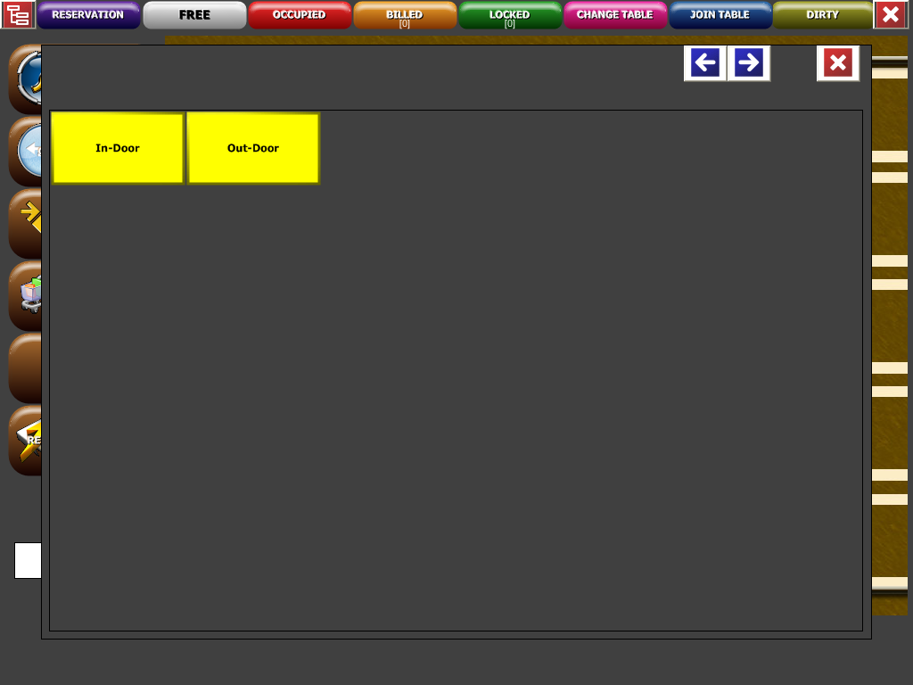

Front End-Zones Control
Different zone area easier for user to define different table seating
Zones Control
38

Slide 39
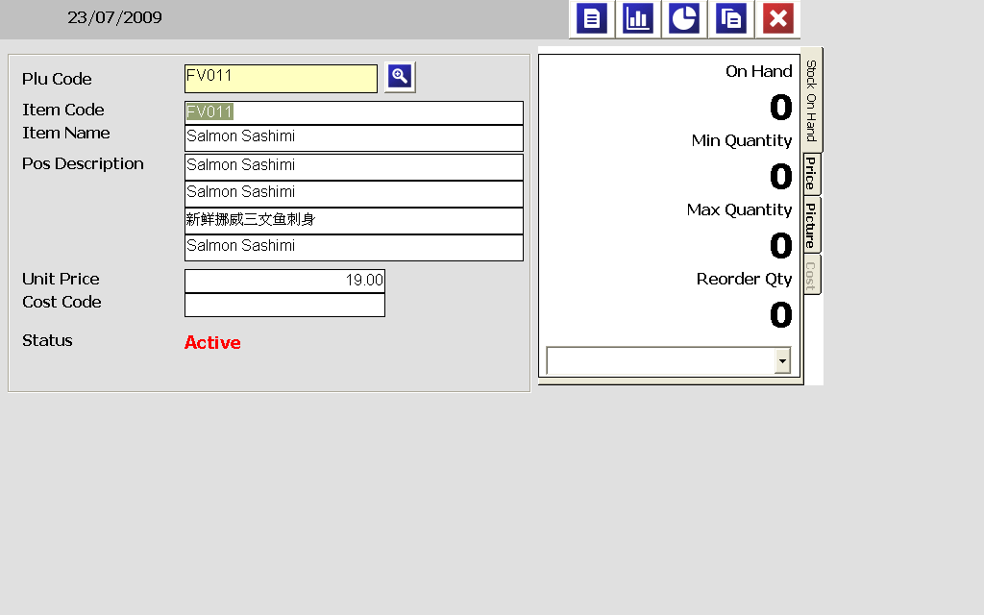

Front End-Stock Enquiry
To keep track and view items stock balance
Stock Enquiry
39

Slide 40
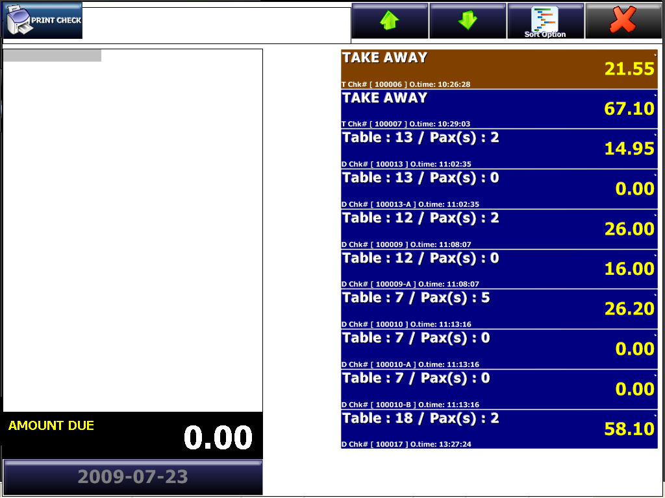

Front End-Print Guest Check
Print Guest Check
40

Slide 41
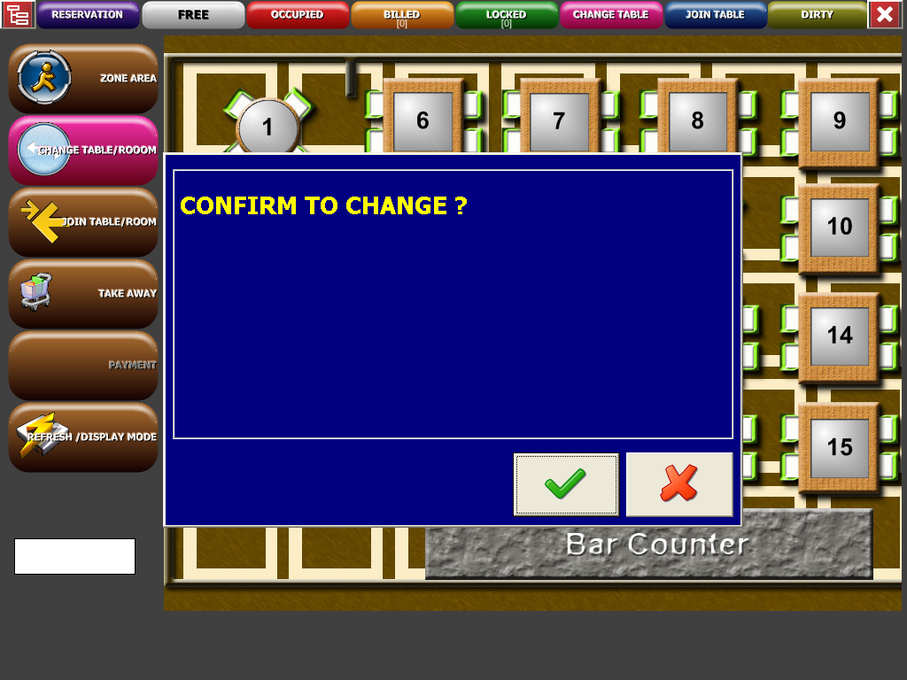

Front End-Change Table/Room
Quick and easy for user to change current table seating to other table
Change Table/Room
41

Slide 42
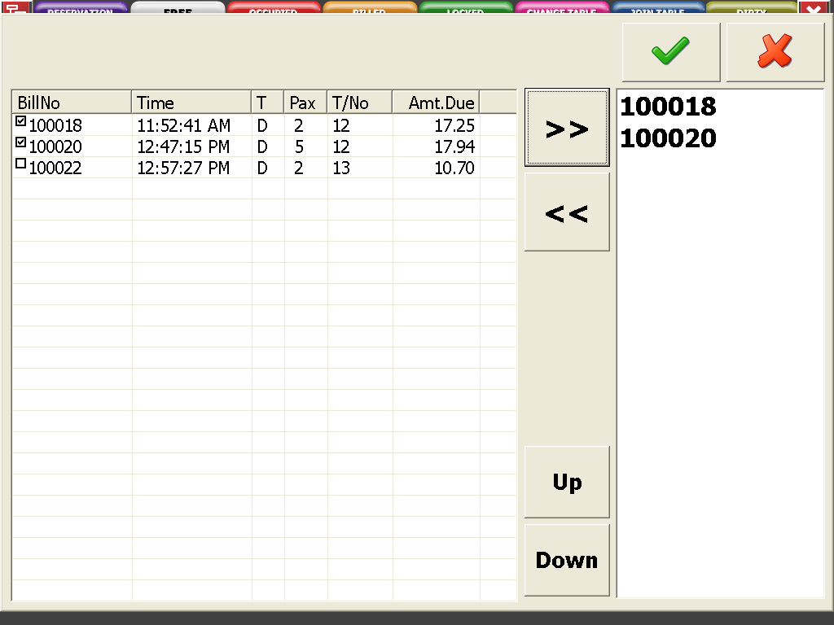



Front End-Join Table/Room
To join or combine multiple bills to make payment together
Join Table/Room
42

Slide 43
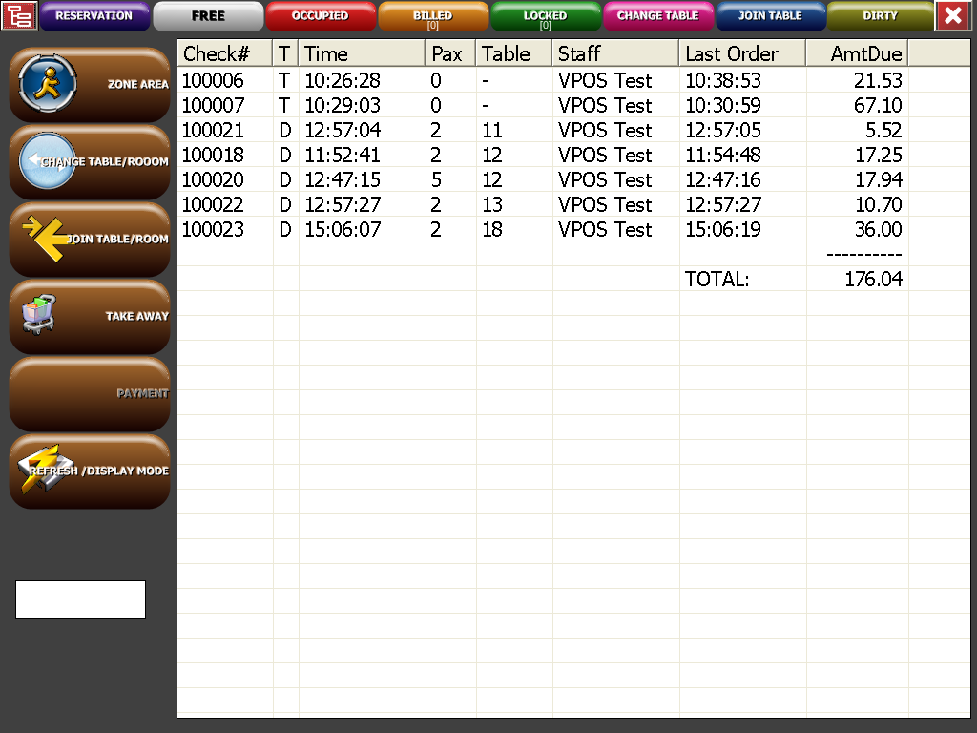

Front End-No Pay Check View
Listing of unsettle or outstanding bills
No Pay Check View
43

Slide 44
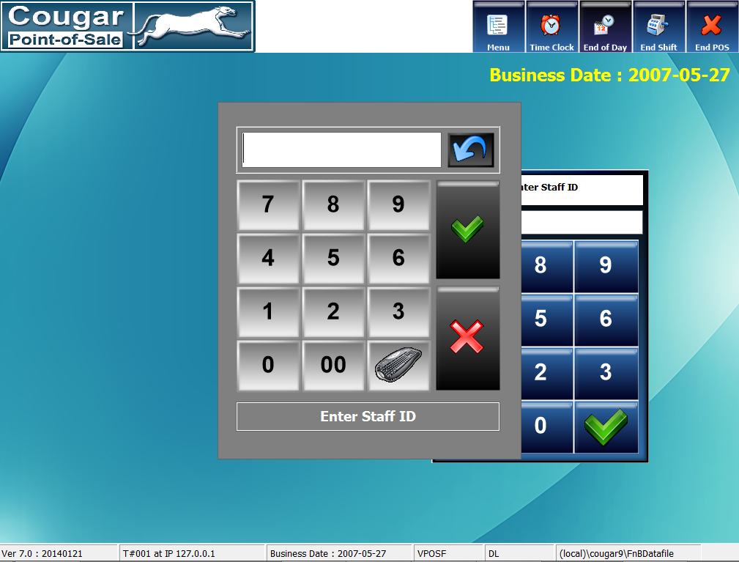

Front End-High Level Control Log In
High Level Control Log In
44

Slide 45
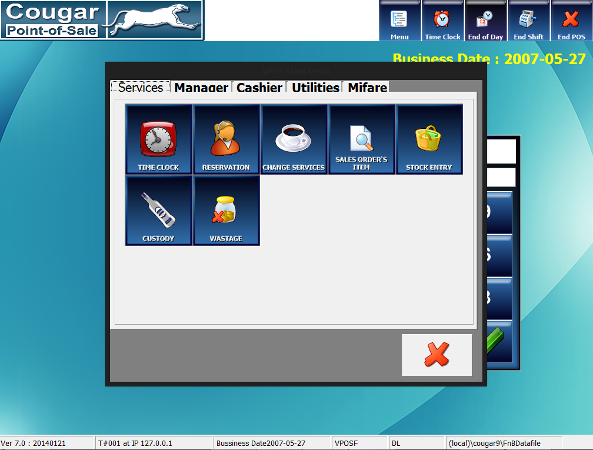
Front End-Services Functions
Services Functions
45

Slide 46
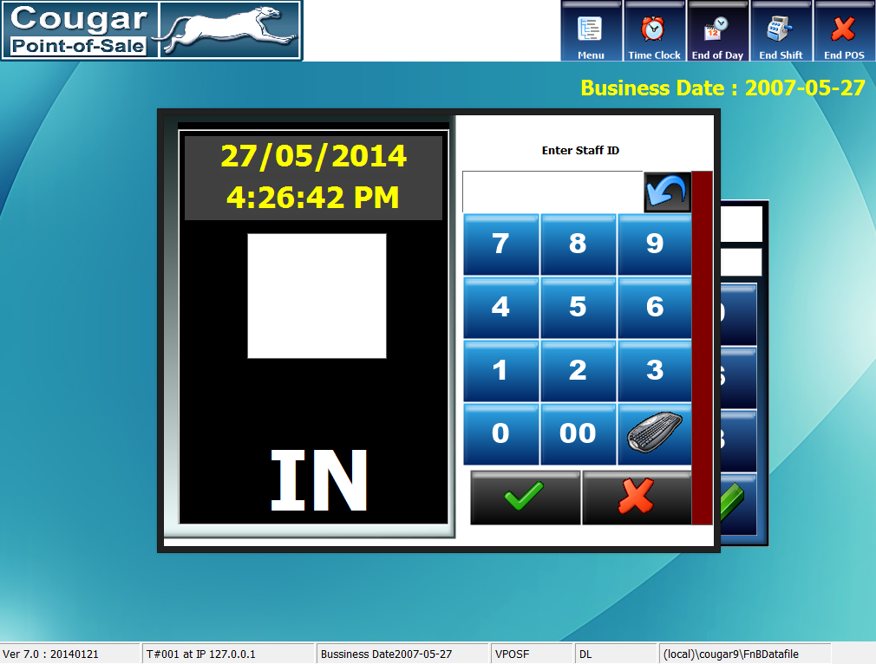

Front End-Time Clock
To make user easier to manage staff attendance (Clock in & out)
Time Clock
46

Slide 47
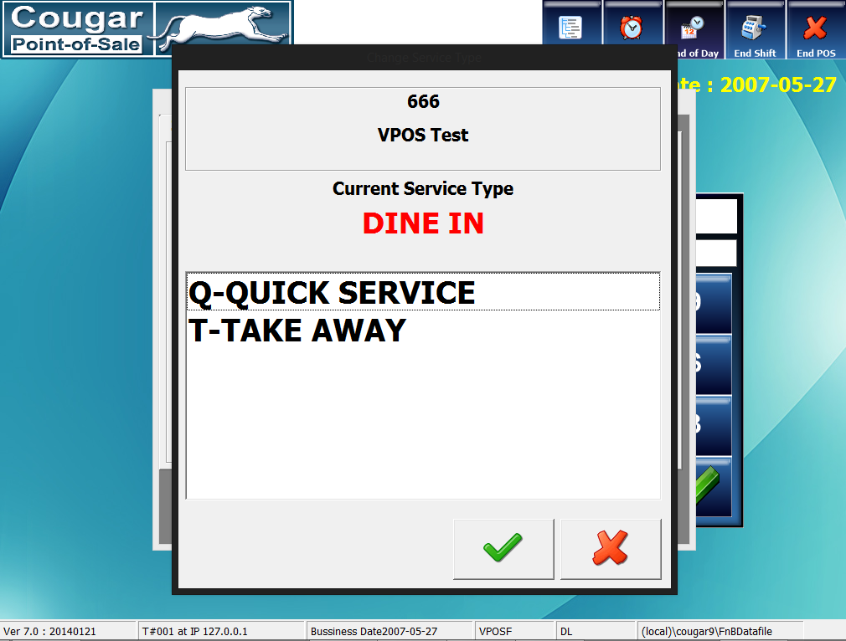

Front End-Change Services
Table fine dine or quick service ordering layout changeable
Change Services
47

Slide 48
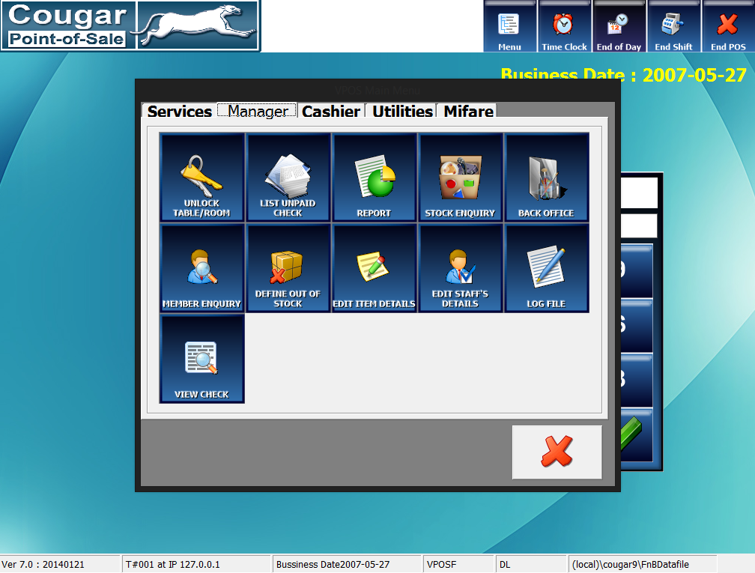
Front End-Manager Functions
Manager Functions
48

Slide 49
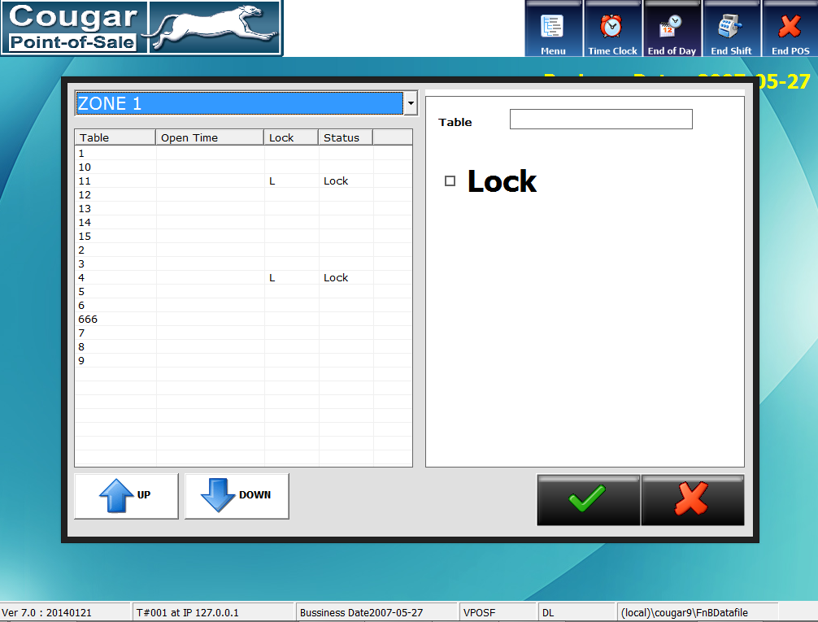

Front End-Unlock Table/Room
To lock or unlock unusable table or room reservation or other purpose
Unlock Table / Room
49

Slide 50
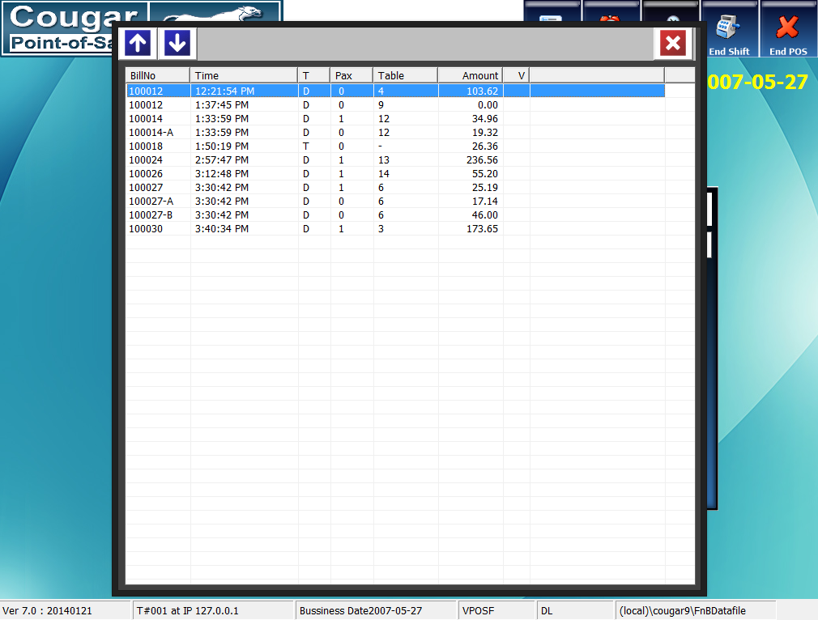
Front End-List Unpaid Check
Listing of unsettle or outstanding bills
List Unpaid Check
50

Slide 51
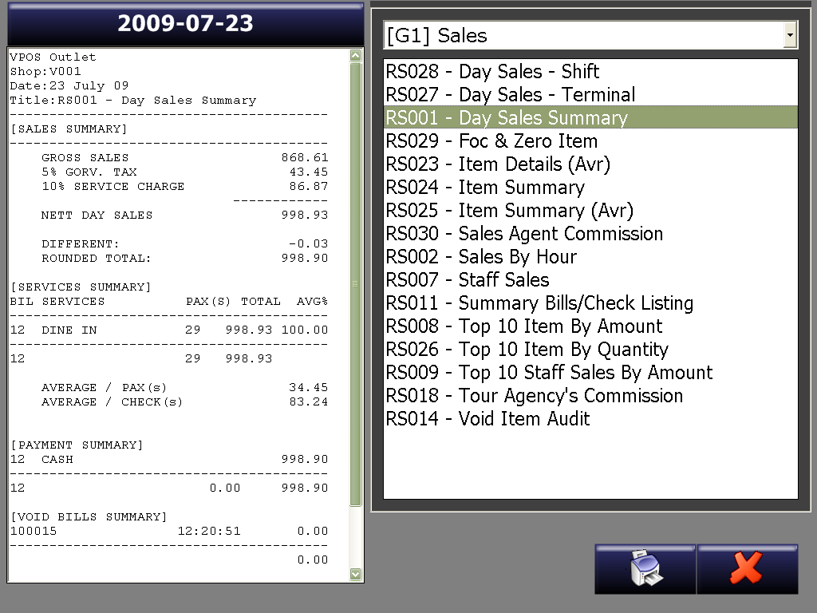

Front End-Report
Review and analysis daily sales transaction
Report
51

Slide 52


Front End-Log File
Review and track Front End Operation Movement
Log File
52

Slide 53


Front End-Member Enquiry
View of Member Details
Member Enquiry
53

Slide 54


Front End-Define Out of Stock
To lock and unlock stock selling items
Define Out-of-Stock
54

Slide 55


Front End-Edit Item Details
Quick and easy to view and edit items description and selling price
Edit Item Details
55

Slide 56


Front End-Edit Staff’s Details
Quick and easy to view or edit staff details
Edit Staff’s Details
56

Slide 57


Front End-View Check
Review of Normal Paid Bill or Void Bill
View Check
57

Slide 58

Front End-Cashier Functions
Cashier Functions
58

Slide 59


Front End-Cash Management
To add in enough small change (Paid In) or take out overload sales cash from drawer (Paid Out)
Cash Management
59

Slide 60

Front End-Cashier Report
Cashier Report
60

Slide 61


Front End-Bill Viewer
To reprint paid bill, recall bill for edit or reverse wrongly paid bills
Bill Viewer
61

Slide 62


Front End-Credit A/C Settlement
To manage customer weekly or monthly outstanding bills
Credit A\C Settlement
62

Slide 63
Cougar V9
Back Office Maintenance Tools
63

Slide 64

Back Office-Log in
Back Office Log In
64

Slide 65

Back Office-Functions
Back Office Functions
65

Slide 66

Back Office-Functions
Back Office Functions
66

Slide 67

Back Office-Item Details
To create, edit or delete menu items details
Item Details
67

Slide 68

Back Office-Item Category Setup
To create, edit or delete menu group arrangement
Item Category Setup
68

Slide 69

Back Office-Standard Promotion
To set up period promotion discount or price
Standard Promotion
69

Slide 70

Back Office-Staff Details
To create, edit or delete new or existing staff details
Staff Details
70

Slide 71

Back Office-Vendor Details
To create, edit or delete supplier details
Vendor Details
71

Slide 72

Back Office-Goods Received Note
To make entry for received goods from supplier
Goods Received Note
72

Slide 73

Back Office-Customer Details
To create, edit or delete customer details
Customer Details
73

Slide 74

Back Office-Item Inquiry
To review and keep track stock items balance and movement
Item Inquiry
74

Slide 75

Back Office-Payment Setup
To create, edit or delete different payment methods
Payment Setup
75

Slide 76

Back Office-Discount Setup
To create, edit or delete value or percentage discount functions
Discount Setup
76

Slide 77

Back Office-Printer Department
To define different items sending destination
Printer Department
77

Slide 78

Back Office-Zone Area Customize
Table seating location arrangement
Zone Area Customize
78

Slide 79
Cougar V9
Backend Analysis Report
79

Slide 80

Reporter-System Log In
Reporter System Log In
80

Slide 81

Reporter-Analysis Report Interface
Analysis Report Interface
81

Slide 82
Reporter-Variety Types of Report
Sales Report
Payment Report
Transaction Report
Stock Report
Consolidate Report
Others Report
Day Sales Summary
Payment Report
Transaction Summary by Bill
Stock Balance
Consolidate Day Sales Summary
Tax Report
Bill Summary
Monthly Report
Transaction Details by Bill
Stock Aging
Consolidate Category Sales Summary
Discount Report
Hourly Sales Summary
Transaction Details
Stock Ledger
Consolidate Item Sales Summary
Top N Sales Report
Monthly Sales
Stock Movement
FOC Item Report
Item Sales
Stock Reorder Advice
Zero Amount Item Report
Sales by Session
Stock Count Sheet
Audit Log
Sales by Category
Sales by Service Type
Sales by Staff
82
Sales by Agent

Slide 83

Reporter-Day Sales Summary
Day Sales Summary
83

Slide 84

Reporter-Hourly Gross Sales
Hourly Gross Sales
84

Slide 85

Reporter-Item Sales Summary
Item Sales Summary
85

Slide 86

Reporter-Bill Summary by Category
Bill Summary by Category
86

Slide 87

Reporter-Payment Report
Payment Report
87

Slide 88

Reporter-Bill Listing
Bill Listing
88

Slide 89

Reporter-Bill Details
Bill Details
89

Slide 90

Reporter-Item Level Discount
Item Level Discount
90

Slide 91

Reporter-Top Sales by Quantity
Top Sales by Quantity
91

Slide 92

Reporter-Stock Balance by Group
Stock Balance by Group
92

Slide 93

Reporter-Audit Trails Report
Audit Trails Report
93

Slide 94
Cougar V9
Successful Stories
94

Slide 95


Slide 96

Thanks for Viewing
Cougar V9 Restaurant POS System

